Slide 1
Lect. 3,4
Medical Nutrition Therapy for lower Gastrointestinal Tract Disorders
Abdulaziz Abbas ph.D
Associate Professor
Food & Nutrition

Slide 2
Common Intestinal Problems
Constipation Diagnosis of constipation is based, in part, on a defecation frequency of fewer than three bowel movements per week.
Other symptoms may include the passage of hard stool and excessive straining during defecation.
Constipation affects up to 28 percent of the population in Western countries and is particularly prevalent among women and older adults.

Slide 3
Causes of Constipation
The risk of constipation is increased in individuals with a low-fiber diet, low food intake, inadequate fluid intake, or low level of physical activity.
All of these factors can extend transit time, leading to increased water reabsorption within the colon and dry, hard stools that are difficult to pass.
Medical conditions often associated with constipation include diabetes mellitus and hypothyroidism.
Neurological conditions such as Parkinson’s disease, spinal cord lesions, and multiple sclerosis may cause motor problems that lead to constipation.

Slide 4
During pregnancy, women often experience constipation because the enlarged uterus presses against the rectum and colon.
Constipation is also a common side effect of several classes of medications and some dietary supplements, including opiatecontaining analgesics, tricyclic antidepressants, anticonvulsants, calcium channel blockers, aluminum-containing antacids, and iron and calcium supplements.

Slide 5
Treatment of Constipation
The primary treatment for constipation is a gradual increase in fiber intake to about 25 grams per day.
High-fiber diets increase stool weight and fecal water content and promote a more rapid transit of materials through the colon.
Foods that increase stool weight the most are wheat bran, fruits, and vegetables.
Bran intake can be increased by adding bran cereals and whole-wheat bread to the diet or by mixing bran powder with beverages or foods.
The transition to a high-fiber diet may be difficult for some people because it can increase intestinal gas, so high-fiber foods should be added gradually, as tolerated.
Fiber supplements such as methylcellulose (Citrucel), psyllium (Metamucil, Fiberall), and polycarbophil (a synthetic fiber) are also effective.
Unlike other fibers, methylcellulose and polycarbophil do not increase intestinal gas.

Slide 6
Consuming adequate fluid (usually 1.5 to 2 liters daily) helps to increase stool frequency in people who are already consuming a high-fiber diet.
An appropriate fluid intake prevents excessive reabsorption of water from the colon, resulting in wetter stools.
Adding prunes or prune juice to the diet is often recommended because prunes contain compounds that have a mild laxative effect.
Laxatives Many laxatives can be purchased without prescription. They work by increasing stool weight, increasing the water content of the stool, or stimulating peristaltic contractions.

Slide 7
Medical Interventions
For patients with severe constipation who do not respond to dietary or laxative treatments, physicians may prescribe medications that stimulate colonic contractions.
Physical therapy are sometimes successful in training patients to relax their pelvic muscles more effectively.
Surgical interventions are a last resort and include colonic resections and colostomy operations.

Slide 8
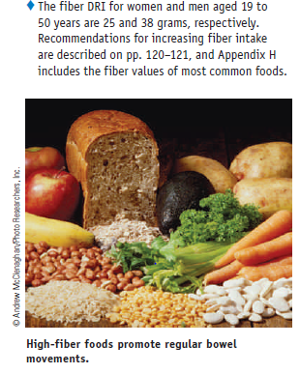

Slide 9
Intestinal Gas
increased intestinal gas (flatulence) may be an unpleasant side effect of consuming a high-fiber diet.
The undigested fibers pass into the colon, where they are fermented by bacteria, which produce gas as a by-product.
Other incompletely digested or poorly absorbed carbohydrates have similar effects; these include fructose, sugar alcohols (sorbitol, xylitol, mannitol), the indigestible carbohydrates in beans (raffinose and stachyose), and some forms of resistant starch, found in grain products and potatoes.
Table 24-2 lists examples of foods commonly associated with excessive gas production, although individual responses vary.

Slide 10
Malabsorption disorders can cause considerable flatulence because the undigested nutrients can be metabolized by colonic bacteria.
Swallowed air that is not expelled by belching may travel to the intestines and be a source of intestinal gas as well.
Many people blame abdominal bloating and pain on excessive gas, but these symptoms do not correlate well with an increase in intestinal gas.
Some individuals who experience frequent symptoms of abdominal bloating and pain are later diagnosed with irritable bowel syndrome or dyspepsia.

Slide 11
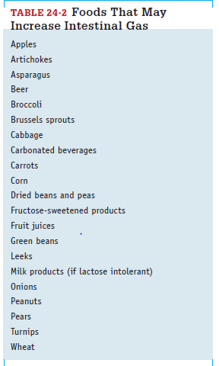

Slide 12
Diarrhea
Diarrhea is characterized by the passage of frequent, watery stools.
In most cases, it lasts for only a day or two and subsides without complication.
Severe or persistent diarrhea, however, can cause dehydration and electrolyte imbalances.
If chronic, it may lead to weight loss and malnutrition.
Diarrhea may be accompanied by other symptoms, such as fever, abdominal cramps, dyspepsia, or bleeding, which help in diagnosing the cause.

Slide 13
Causes of Diarrhea
Diarrhea is a complication of various GI disorders and may also be induced by infections, medications, or dietary substances.
It results from inadequate fluid reabsorption in the intestines, sometimes in conjunction with an increase in intestinal secretions.
In osmotic diarrhea, unabsorbed nutrients or other substances attract water to the colon and increase fecal water content; the usual causes include high intakes of poorly absorbed sugars (such as sorbitol, mannitol, or fructose), lactase deficiency, and ingestion of laxatives that contain magnesium or phosphates.

Slide 14
In secretory diarrhea, the fluid secreted by the intestines exceeds the amount that can be reabsorbed by intestinal cells.
Secretory diarrhea is often due to bacterial food poisoning but can also be caused by intestinal inflammation and various chemical substances.
Motility disorders can result in diarrhea because they accelerate the transit of residue, reducing the contact time available for fluid reabsorption.

Slide 15
Acute cases of diarrhea start abruptly and may persist for several weeks; they are frequently caused by viral, bacterial, or protozoal infections or occur as a side effect of medications.
Chronic diarrhea, which persists for three weeks or longer, can result from malabsorption disorders, inflammatory diseases, motility disorders, infectious diseases, radiation treatment, and many other conditions.
diarrhea is a frequent complication of tube feedings and it may also occur when enteral feedings are resumed after a period of bowel rest.

Slide 16
Medical Treatment of Diarrhea
Correcting the underlying medical problem is the first step in treating diarrhea.
For example, antibiotics can be prescribed for treating intestinal infections. If a medication is the cause of diarrhea, a different drug may be suggested. If certain foods are responsible, they can be omitted from the diet.
Bulk-forming agents such as psyllium (Metamucil) or methylcellulose (Citrucel) can help to reduce the liquidity of the stool.
If chronic diarrhea does not respond to treatment, antidiarrheal drugs may be prescribed to slow GI motility or reduce intestinal secretions.
Probiotics may be beneficial for certain types of diarrhea (especially diarrhea caused by infections), but standard treatment protocols have not been developed.
People with severe, intractable diarrhea sometimes require total parenteral nutrition.

Slide 17
Oral Rehydration Therapy
Severe diarrhea requires the replacement of lost fluid and electrolytes.
Oral rehydration solutions can be purchased or easily mixed using water, salts, and glucose or sucrose. The addition of carbohydrate to the solution facilitates sodium and water absorption.
Commercial sports drinks are not ideal fluids for rehydration because their sodium content is too low, but they can be used if accompanied by salty snack foods.
When diarrhea results in extreme dehydration, intravenous solutions are used to quickly replenish fluid and electrolytes.

Slide 18
Nutrition Therapy for Diarrhea
Because diarrhea can develop for numerous reasons, the nutrition prescription depends on the medical diagnosis and severity of the condition.
The dietary treatment often recommended is a low-fiber, low-fat, lactose-free diet.
The diet limits foods that contribute to colonic residue, such as those with significant amounts of fiber, resistant starch, fructose, sugar alcohols, and lactose (in lactose-intolerant individuals).
Fructose and sugar alcohols, which are poorly absorbed, retain fluids in the colon and contribute to osmotic diarrhea.
Similarly, milk products may worsen osmotic diarrhea in persons who are lactose intolerant.

Slide 19
Avoidance of fatty foods is recommended because they can sometimes aggravate diarrhea. Gas-producing foods (those with poorly digested or absorbed carbohydrates) can increase intestinal distention and cause additional discomfort.
Patients should avoid caffeinated coffee and tea because caffeine stimulates GI motility and can thereby reduce water reabsorption.
In the treatment of formula fed infants, apple pectin or banana flakes are sometimes added to formulas to help thicken stool consistency.
Table 24-3 lists examples of foods that may worsen diarrhea, although individual tolerances vary.

Slide 21
Malabsorption Syndromes
To digest and absorb nutrients, we depend on normal digestive secretions and healthy intestinal mucosa.
Malabsorption can therefore be caused by pancreatic disorders that lead to enzyme or bicarbonate deficiencies, conditions that lead to bile deficiency, and inflammatory conditions or medical treatments that damage intestinal tissue.
In some cases, the treatment of an intestinal disorder requires surgical removal of a section of the small intestine, leaving minimal absorptive capacity in the portion that remains.
In addition, various medications can damage the mucosa and impair the digestive and absorptive functions of the small intestine. T

Slide 22
When malabsorption is caused by pancreatic enzyme deficiencies, all macronutrients—protein, carbohydrate, and fat—may be affected.
When fat is malabsorbed, fat-soluble nutrients and some minerals are usually malabsorbed as well.
Malabsorption disorders and their treatments can tax nutrition status further by causing complications that alter food intake, raise nutrient needs, and incur additional nutrient losses.

Slide 23
Fat Malabsorption
Fat is the nutrient most frequently malabsorbed because both digestive enzymes and bile must be present for its digestion.
Thus, fat malabsorption often develops when an illness interferes with the production or secretion of either pancreatic lipase or bile.
For example, both pancreatitis and cystic fibrosis can reduce the secretion of pancreatic lipase, whereas severe liver disease can cause bile insufficiency.
Motility disorders that accelerate gastric emptying or intestinal transit can cause fat malabsorption because they prevent the normal mixing of dietary fat with lipase and bile.

Slide 24
Fat malabsorption may also be caused by conditions or treatments that damage the intestinal mucosa, such as inflammatory bowel diseases, AIDS, and radiation treatments for cancer.
Fat malabsorption is often evidenced by steatorrhea, the presence of excessive fat in the stools.
Steatorrhea can be evaluated by placing the patient on a high-fat diet (100 grams per day), performing a 48- to 72-hour stool collection, and measuring the stool’s fat content.
Healthy individuals generally excrete less than 7 grams of fat per day under these conditions.

Slide 25
Consequences of Fat Malabsorption
Fat malabsorption is associated with losses of food energy, essential fatty acids, fat-soluble vitamins, and some minerals.
Weight loss may result if the individual does not consume alternative sources of energy. Deficiencies of fat-soluble vitamins and essential fatty acids are common in chronic conditions.
Malabsorption of some minerals, including calcium, magnesium, and zinc, often occurs because the minerals form soaps with the unabsorbed fatty acids and bile acids.
Calcium deficiency may lead to bone loss, which is further aggravated by the vitamin D deficiency that may be present due to fat malabsorption.

Slide 26
Another consequence of fat malabsorption is an increased risk of kidney stones, which are most often composed of calcium oxalate.
The oxalates in foods ordinarily bind to calcium in the small intestine and are excreted in the stool.
If calcium instead binds to fatty acids or bile acids, the oxalates are free to be absorbed into the blood and are ultimately excreted in the urine.
The risk of developing oxalate stones increases when urinary oxalate levels are high.

Slide 27
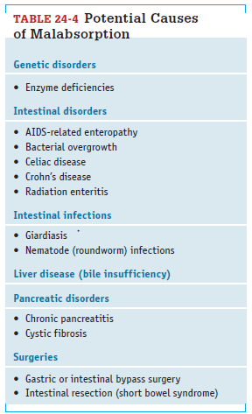

Slide 28
Nutrition Therapy for Fat Malabsorption
If steatorrhea does not improve, a fat-controlled diet may be recommended (see Table 24-5).
The objectives of the diet are to relieve intestinal symptoms that are aggravated by fat intake (such as diarrhea and flatulence) and to reduce vitamin and mineral losses.
Fat should not be restricted more than necessary because fat is an important source of energy.
Medium-chain triglycerides (MCT), which do not require lipase or bile for digestion and absorption, can be used as an alternative source of dietary fat, although MCT oil does not provide essential fatty acids.

Slide 29
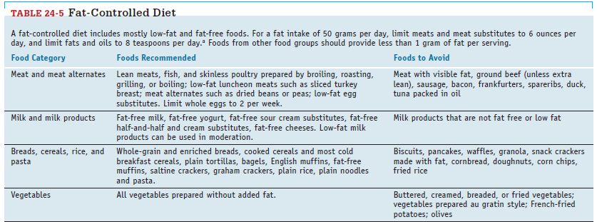

Slide 32
Bacterial Overgrowth
the GI tract is protected from bacterial overgrowth by gastric acid, which destroys bacteria; peristalsis, which flushes bacteria through the small intestine before they multiply; and immunoglobulins secreted into the GI lumen.
When bacterial overgrowth does occur, it can lead to fat malabsorption because the bacteria dismantle the bile acids needed for fat emulsification.
Deficiencies of the fat-soluble vitamins A, D, and E may eventually develop. The bacteria also produce enzymes and toxins that disturb the intestinal mucosa, destroying some mucosal enzymes (especially lactase) and possibly reducing the absorptive surface area.
Some types of bacteria metabolize vitamin B12, reducing its absorption and increasing the risk of deficiency.
Although symptoms of bacterial overgrowth are often minor and nonspecific, severe cases may lead to chronic diarrhea, steatorrhea, flatulence, bloating, and weight loss.

Slide 33
Causes of Bacterial Overgrowth
Conditions that impair intestinal motility and allow material to stagnate can greatly increase susceptibility to bacterial overgrowth.
For example, in some types of gastric surgery, a portion of the small intestine is bypassed, preventing the flow of material in the bypassed region and allowing bacteria to flourish.
Intestinal motility can also be reduced by strictures, obstructions, and diverticula in the small intestine, as well as by some chronic illnesses, including diabetes mellitus, and chronic kidney disease.
Reduced secretions of gastric acid may also lead to bacterial overgrowth. Possible causes include atrophic gastritis, use of acid-suppressing medications, and some gastrectomy procedures.

Slide 34
Treatment for Bacterial Overgrowth
Treatment may include antibiotics to suppress bacterial growth and surgical correction of the anatomical defects that contribute to a motility disorder.
Medications may be given to stimulate peristalsis.
A lactose-restricted diet may reduce flatulence and diarrhea in some individuals.
Dietary supplements can help to correct nutrient deficiencies, especially deficiencies of the fat-soluble vitamins A, D, and E; calcium (which combines with malabsorbed fatty acids); and vitamin B12.

Slide 35
Conditions Affecting the Pancreas
pancreatic disorders can lead to maldigestion and malabsorption due to the impaired secretion of digestive enzymes.
Pancreatitis Pancreatitis is an inflammatory disease of the pancreas.
Although mild cases may subside in a few days, other cases can persist for weeks or months.
Chronic pancreatitis can lead to irreversible damage to pancreatic tissue and permanent loss of function.

Slide 36
Acute Pancreatitis
In acute pancreatitis, the digestive enzymes within pancreatic cells become prematurely activated, causing destruction of pancreatic tissue and subsequent inflammation.
About 70 to 80 percent of acute cases are caused by gallstones or alcohol abuse; less frequent causes include elevated blood triglyceride levels (greater than 1000 milligrams per deciliter) or exposure to toxins.
Common symptoms of acute pancreatitis include severe abdominal pain, nausea and vomiting, and abdominal distention.
Elevated serum levels of amylase and lipase—released by damaged pancreatic tissue into the blood—help to confirm the diagnosis.
In most patients, the condition resolves within a week with no complications.
More severe cases may lead to chronic pancreatitis, infection, or multiple organ failure.

Slide 37
Nutrition Therapy for Acute Pancreatitis
The initial treatment for acute pancreatitis is supportive and includes pain control, intravenous hydration, and supplementary oxygen, if necessary.
Oral fluids and food are withheld until the patient is pain free and experiences no nausea or vomiting. Afterward, patients may consume a liquid diet or small low-fat meals, as tolerated (fat stimulates the pancreas more than other nutrients).
In severe pancreatitis, tube feedings may be necessary; either standard formulas or elemental formulas may be used, depending on patient tolerance.
Protein and energy needs are high in severe cases due to the catabolic and hypermetabolic effects of inflammation.
Patients with acute pancreatitis require nutrient supplementation until food intake can meet nutritional needs.

Slide 38
Chronic Pancreatitis
Chronic pancreatitis is characterized by progressive, permanent damage to pancreatic tissue, resulting in the impaired secretion of digestive enzymes and bicarbonate.
About 70 percent of cases are caused by excessive alcohol consumption.
Unlike acute pancreatitis, chronic pancreatitis is not caused by gallstones.
In chronic pancreatitis, abdominal pain is often severe and unrelenting and may worsen with eating. Analgesics or opiate drugs are often needed for pain control.
Fat maldigestion develops sooner than maldigestion of protein or carbohydrate, and steatorrhea is common in advanced cases. Food avoidance (due to pain associated with eating) and malabsorption may lead to weight loss and malnutrition.
Longterm illness is associated with reductions in both insulin and glucagon secretions, and diabetes eventually develops in 40 to 80 percent of patients.

Slide 39
Nutrition Therapy for Chronic Pancreatitis
The objectives of nutrition therapy are to correct malnutrition, reduce malabsorption, and prevent symptom recurrence.
Dietary supplements are used to correct nutrient deficiencies, which may be due to malabsorption or to the alcohol abuse that caused the disease.
To improve food tolerance, patients should consume small, low-fat meals. They should also avoid alcohol completely and quit smoking cigarettes, as these substances can exacerbate illness and interfere with healing.

Slide 40
Steatorrhea is usually treated with pancreatic enzyme replacement.
Pancreatic enzymes are often enteric coated to resist the acidity of the stomach and do not dissolve until the pH is above 5.5.
If nonenteric-coated preparations are used, acid-suppressing drugs are also required.
Fecal fat concentrations must be monitored to determine if the enzyme treatment has been effective.
In some cases, a fat- controlled diet may help to reduce symptoms, and MCT oil can be used as an alternative source of fat kcalories.

Slide 41
Conditions Affecting the Small Intestine
When the intestinal mucosa is damaged due to inflammation, infection, or other causes, malabsorption is the likely outcome.
Celiac disease and inflammatory bowel diseases are intestinal conditions that can impair mucosal function, whereas short bowel syndrome is the malabsorption disorder that results when a significant portion of the small intestine is surgically removed.
Celiac Disease
Celiac disease is an immune disorder characterized by an abnormal immune response to a protein fraction in wheat gluten and to related proteins in barley and rye. The reaction to gluten causes severe damage to the intestinal mucosa and subsequent malabsorption. Celiac disease may affect approximately 1 percent of individuals in the United States.

Slide 42
Consequences of Celiac Disease The immune reaction to gluten can cause striking changes in intestinal tissue.
In affected areas, the absorptive surface appears flattened due to the shortening or absence of villi and overdeveloped crypts (see the photos).
The reduction in mucosal surface area (and, therefore, in intestinal digestive enzymes) can be substantial.

Slide 43
The damage may be restricted to the duodenum or may involve the full length of the small intestine.
Individuals with severe disease may malabsorb all nutrients to some degree, especially the macronutrients, calcium, iron, folate, the fat-soluble vitamins, and vitamin B12.

Slide 44
Symptoms of celiac disease include GI disturbances such as diarrhea, steatorrhea, and flatulence. Because lactase deficiency can result from mucosal damage, milk products may exacerbate GI symptoms.
Due to nutrient malabsorption, children with celiac disease often exhibit poor growth, low body weights, muscle wasting, and anemia.
Adults may develop anemia, bone disorders, neurological symptoms, and fertility problems.

Slide 45
Individuals with celiac disease who do not eliminate gluten from the diet are at increased risk of developing intestinal and lymphatic cancers.
Some gluten-sensitive individuals may have few GI symptoms but react to gluten by developing a severe rash.
This condition is called dermatitis herpetiformis and requires dietary adjustments similar to those for celiac disease.

Slide 46
Nutrition Therapy for Celiac Disease
The treatment for celiac disease is lifelong adherence to a gluten-free diet.
Improvement in symptoms is often evident within several weeks, although mucosal healing can sometimes take years. If lactase deficiency is suspected, patients should avoid lactose-containing foods until the intestine has recovered. Dietary supplements can be used to meet micronutrient needs and reverse deficiencies.

Slide 47
The gluten-free diet eliminates foods that contain wheat, barley, and rye (see Table 24-6). Because many foods contain ingredients derived from these grains, foods that are problematic are not always obvious.
Even small amounts of gluten may cause symptoms in some people, so patients need to check ingredient lists on food labels carefully.
Gluten-containing products that may be overlooked include beer, caramel coloring, coffee substitutes, communion wafers, imitation meats, malt syrup, medications, salad dressings, and soy sauce.
Special gluten-free products can be purchased to replace common food items such as bread, pasta, and cereals.

Slide 48
Although somewhat expensive, these foods increase food choices and allow celiac patients to enjoy foods that would otherwise be forbidden.
Patients should also be instructed in food preparation methods that prevent cross-contamination from utensils, cutting boards, and toasters.
Although most people with celiac disease can safely consume moderate amounts of oats, most oats grown in the United States are contaminated with wheat, barley, or rye.

Slide 49
Oats are usually grown in rotation with other grains and may become contaminated during harvesting or processing.
However, several oat manufacturers in the United States produce oats in dedicated facilities and test the products to ensure that they are gluten free.
Individuals who wish to include oats in their diet should be advised to purchase only uncontaminated oats and to limit intakes to the amounts found to be safe (about 1/2 cup of dry rolled oats per day).

Slide 51
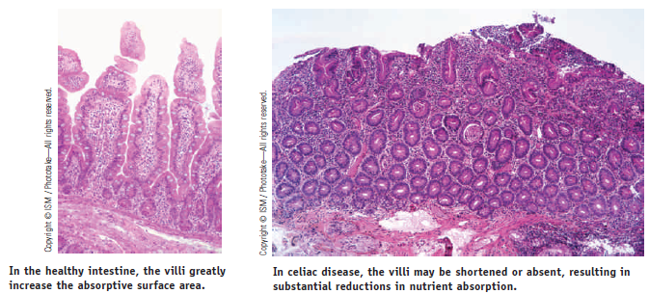

Slide 52
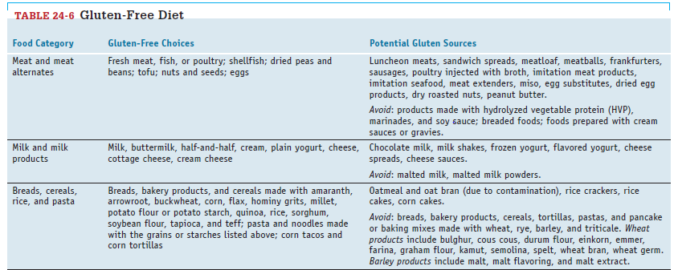

Slide 54
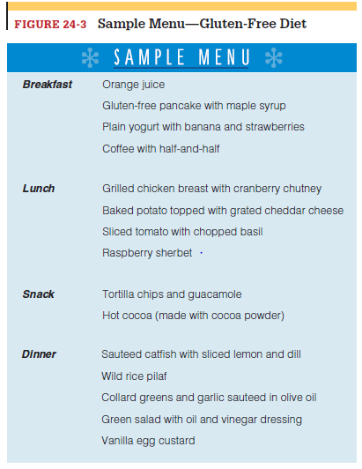

Slide 55
Inflammatory Bowel Diseases
Inflammatory bowel diseases are chronic inflammatory illnesses characterized by abnormal immune responses in the GI tract.
Both genetic and environmental factors are believed to contribute to the development of these diseases.
Table 24-7 compares the two major forms of inflammatory bowel disease, Crohn’s disease and ulcerative colitis.
Crohn’s disease usually involves the small intestine and may lead to nutrient malabsorption, whereas ulcerative colitis affects the large intestine, where little nutrient absorption occurs.
Nutrient losses can result from tissue damage, bleeding, and diarrhea.

Slide 56
Complications of Crohn’s Disease
Crohn’s disease may occur in any region of the GI tract, but most cases involve the ileum. Lesions may develop in different areas in the intestine.
During exacerbations, the inflammation may extend deeply into intestinal tissue and be accompanied by ulcerations, fissures, and fistulas.
Loops of intestine may become matted together. Scar tissue eventually thickens and stiffens the intestinal wall, narrowing the lumen and possibly causing strictures or obstructions.
About three fourths of patients require surgery within 20 years of diagnosis. Patients with Crohn’s disease are also at increased risk of developing intestinal cancers.
Malnutrition may result from malabsorption, nutrient losses (especially of protein) associated with the tissue damage, reduced food intake, and surgical resections that shorten the small intestine.

Slide 57
If the ileum is affected, bile acids may become depleted, causing malabsorption of fat, fat-soluble vitamins, calcium, magnesium, and zinc (the minerals bind to the unabsorbed fatty acids).
Because the ileum is the site of vitamin B12 absorption, deficiency can develop unless the patient is given vitamin B12 injections.
Anemia may result from bleeding, inadequate absorption of the nutrients involved in blood cell formation, or the metabolic effects of chronic illness.
Anorexia often develops due to abdominal discomfort and the effects of cytokines produced during the inflammatory process.

Slide 59
Complications of Ulcerative Colitis
Ulcerative colitis always involves the rectum and usually extends into the colon. Inflammation is continuous along the length of intestine affected, ending abruptly at the area where healthy tissue begins.
Tissue erosion or ulceration develops primarily in the mucosa and submucosa (the layers of intestinal tissue closest to the lumen). During active episodes, patients have frequent, urgent bowel movements that are small in volume. Stools are often streaked with blood and contain mucus.
Although mild disease may cause few complications, weight loss, fever, and weakness are common when most of the colon is involved.
Severe disease is often associated with anemia (due to blood loss), dehydration, and electrolyte imbalances. Protein losses from the inflamed tissue can be substantial.

Slide 60
Drug Treatment of Inflammatory Bowel Diseases
Medications help to control symptoms, reduce inflammation, and minimize complications. The drugs prescribed include antidiarrheal agents, immuno suppressants, anti-inflammatory drugs (usually corticosteroids and salicylates), and antibiotics.
Although these medications may allow the patient to achieve and maintain remission, some may cause side effects that are detrimental to nutrition status.
The Diet-Drug Interactions feature lists some nutrition-related effects of the medications used in inflammatory bowel diseases.

Slide 61
Nutrition Therapy for Crohn’s Disease
Crohn’s disease often requires aggressive dietary management because it can lead to protein-energy malnutrition (PEM), nutrient deficiencies, and growth failure in children.
During disease exacerbations, a low-fiber, low-fat diet provided in small, frequent feedings can minimize stool output and reduce symptoms of malabsorption.
High kcalorie, high-protein diets may be prescribed to prevent or treat malnutrition or promote healing; protein needs may be 50 percent higher than DRI levels.
Liquid supplements may help to increase energy intake and improve weight gain.

Slide 62
Vitamin and mineral supplements are usually necessary, especially if nutrient malabsorption is present; nutrients at risk include calcium, iron, magnesium, zinc, folate, vitamin B12, and vitamin D.
In some instances, tube feedings are used to supplement the diet or may be the sole means of providing nutrients; some patients may tolerate elemental formulas more easily than standard formulas.
Table 24-8 includes examples of other dietary adjustments that may be beneficial for patients with Crohn’s disease.
Adequate fluid replacement should be encouraged in patients with diarrhea. Individuals with partial obstructions may need to restrict high-fiber foods.
Although research studies suggest that supplementation with omega-3 fatty acids, glutamine, or probiotics may be helpful, more research is necessary to confirm these benefits.

Slide 63
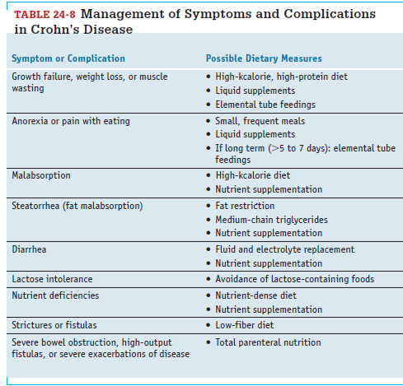

Slide 64
Nutrition Therapy for Ulcerative Colitis
In most cases, the diet for ulcerative colitis requires few adjustments.
During disease exacerbations, emphasis is given to restoring fluid and electrolyte balances and correcting deficiencies that result from protein and blood losses; dietary adjustments are based on the extent of bleeding and diarrhea output.
Thus, adequate protein, energy, fluid, and electrolytes need to be provided. A low-fiber diet may reduce irritation by minimizing fecal volume.
If colon function becomes severely impaired, food and fluids may be withheld and fluids and electrolytes supplied intravenously until colon function is restored.

Slide 65
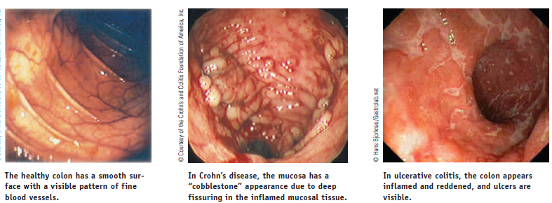

Slide 66
Short Bowel Syndrome
The treatment of Crohn’s disease, cancers of the small intestine, and other intestinal disorders may include the surgical resection of a major portion of the small intestine.
Short bowel syndrome is the malabsorption syndrome that results when the absorptive capacity of the remaining intestine is insufficient for meeting nutritional needs.
Without appropriate dietary adjustments, short bowel syndrome can result in fluid and electrolyte imbalances and multiple nutrient deficiencies.
Symptoms include diarrhea, steatorrhea, dehydration, weight loss, and growth impairment in children.

Slide 67
Consequences of Short Bowel Syndrome
Generally, up to 50 percent of the small intestine can be resected without serious nutritional consequences.
More extensive resections lead to generalized malabsorption, and patients may need lifelong parenteral nutrition to supplement oral intakes.
Other problems that may develop include kidney stones (due to the effects of fat malabsorption on urinary oxalate levels, and gallstones (due to bile malabsorption and the subsequent imbalance between bile acid and cholesterol concentrations in bile.

Slide 68
Intestinal Adaptation
After an intestinal resection, the remaining intestine undergoes intestinal adaptation, an adaptive response that dramatically improves the intestine’s absorptive capacity.
Adaptation depends on the presence of nutrients and GI secretions in the lumen, and therefore oral intakes are begun as soon as possible after surgery to stimulate the growth of intestinal tissue.
During this period, the remaining section of intestine develops taller villi and deeper crypts and also grows in length and diameter; these changes dramatically increase the absorptive surface area of the remaining intestine.
The ileum has a greater capacity for adaptation than the jejunum; thus, removal of the ileum has more severe consequences than removal of the jejunum.

Slide 69
Loss of the ileum permanently disrupts both vitamin B12 and bile acid absorption.
Depletion of bile acids exacerbates fat malabsorption, and the unabsorbed bile acids irritate the colon walls and can worsen diarrhea.
Adaptation is achieved more easily if the colon is present, because the colon’s resident bacteria can metabolize unabsorbed carbohydrates and produce some usable nutrients (such as short-chain fatty acids).
An intact colon also helps to reduce losses of fluids and electrolytes.

Slide 70
Nutrition Therapy for Short Bowel Syndrome
Immediately after a resection, fluids and electrolytes must be supplied intravenously. In the first few weeks after surgery, the fluid losses from diarrhea can be substantial, so appropriate rehydration therapy is critical to recovery.
Antidiarrheal medications may be needed to limit losses.
Total parenteral nutrition meets nutrient needs after surgery and is gradually reduced as oral feedings increase. To promote intestinal adaptation, oral feedings may be started within a week after surgery.
Initial oral intake may consist of sips of clear, sugar-free liquids, progressing to larger amounts of liquid formulas and then to solid foods, as tolerated.
Very small, frequent feedings can utilize the remaining intestine most efficiently.
Some patients require tube feedings in addition to oral feedings to successfully meet nutrient needs.

Slide 71
The exact diet prescribed for short bowel syndrome depends on the portion of intestine removed, the length of remaining intestine, and whether the colon is still intact.
A high-kcalorie diet is typically recommended to compensate for malabsorption; thus, a high-fat, low-carbohydrate diet may be recommended if the fat is sufficiently tolerated.
Conversely, a high-complex-carbohydrate, low-fat diet may be suggested for patients who have an intact colon, because the colon bacteria can metabolize the unabsorbed carbohydrate and produce short-chain fatty acids (contributing an additional 310 to 1170 kcalories daily), and the low fat intake can improve steatorrhea.

Slide 72
In some cases, medium-chain triglycerides may be added as an energy source.
Patients should avoid concentrated sweets, which draw fluid into the intestines, if they cause additional diarrhea.
Some patients may be lactose intolerant, but they can minimize symptoms by consuming limited amounts of milk at one time.
Due to the high risk of developing kidney stones as a result of calcium malabsorption, a low-oxalate diet may be recommended.

Slide 73
Vitamin and mineral supplements can prevent deficiencies from developing due to malabsorption. If fat is malabsorbed, patients may need supplements of fat-soluble vitamins, calcium, magnesium, and zinc.
If a large portion of the ileum has been removed, vitamin B12 must be injected. Iron absorption is likely to be compromised only if upper portions of the small intestine have been removed.
Individuals with fewer than 100 centimeters of jejunum and no colon usually require intravenous fluids and parenteral nutrition to survive.

Slide 74
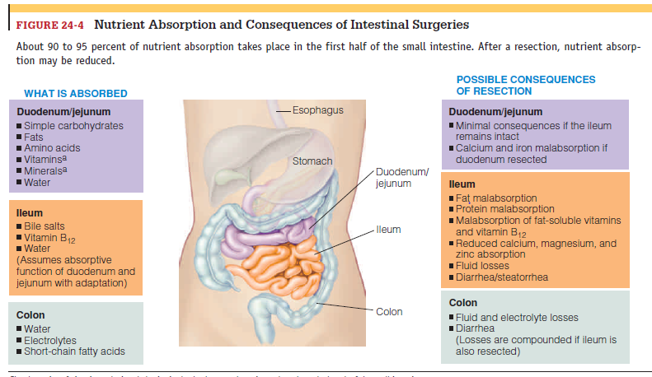

Slide 75
the Large Intestine
In the large intestine, the colon moves undigested materials to the rectum and has a central role in maintaining fluid and electrolyte balances.
Its bacterial population ferments undigested nutrients and produces short-chain fatty acids and some vitamins that our bodies can absorb and use.
Irritable Bowel Syndrome
People with irritable bowel syndrome experience chronic and recurring intestinal symptoms that cannot be explained by specific physical abnormalities.
The symptoms usually include disturbed defecation (diarrhea and/or constipation), flatulence, and abdominal discomfort or pain; the pain is often aggravated by eating and relieved by defecation.
In some patients, symptoms are mild; in others, the disturbances in colonic function can interfere with work and social activities enough to dramatically alter the person’s lifestyle and sense of well-being.

Slide 76
Although the causes of irritable bowel syndrome remain elusive, people with the disorder tend to have excessive colonic responses to meals, GI hormones, and stress.
Intestinal motility after meals may be excessive, leading to diarrhea, or be reduced, causing constipation.
Some patients may have had a bacterial infection that initiated their GI problems; other show signs of low-grade intestinal inflammation of uncertain cause. Symptoms often worsen during periods of psychological stress.

Slide 77
Diagnosing irritable bowel syndrome is often difficult because its symptoms are typical of other GI disorders and laboratory tests for the condition are nonexistent.
Up to 5 percent of patients with symptoms of irritable bowel syndrome are found to have celiac disease.
Other GI disturbances that may cause similar symptoms include inflammatory bowel diseases, lactose intolerance, hypothyroidism or hyperthyroidism, GI infections, and intestinal cancers.
Between 40 and 94 percent of patients diagnosed with irritable bowel syndrome have coexisting psychiatric illnesses, such as anxiety and depression, which can exacerbate symptoms.

Slide 78
Treatment of Irritable Bowel Syndrome
Medical treatment of irritable bowel syndrome often includes dietary adjustments, stress management, and behavioral therapies. Medications may be prescribed to manage symptoms, although they are not always helpful. The drugs prescribed may include antidiarrheal drugs, antidepressants, and laxatives.
Nutrition Therapy for Irritable Bowel Syndrome
The most common recommendation is to gradually increase fiber intake from food or supplements to relieve constipation and improve stool bulk.
However, clinical studies suggest that additional fiber has only marginal effectiveness in improving symptoms and may worsen flatulence.

Slide 79
Foods that aggravate symptoms may include fried or fatty foods, gas-producing foods, milk products (not necessarily due to lactose intolerance), wheat products, coffee (with or without caffeine), and alcoholic beverages; however, individual tolerances are best determined by trial and error.
A careful evaluation of the dietary patterns that exacerbate symptoms may uncover the foods and habits most closely associated with intestinal discomfort.
Treatments under investigation for irritable bowel syndrome include peppermint oil, which relaxes smooth muscle within the GI tract, and various types of probiotics.

Slide 80
Diverticular Disease of the Colon
Diverticulosis refers to the presence of pebble-sized herniations (outpockets) in the intestinal wall, known as diverticula.
The prevalence of diverticulosis increases with age, occurring in 50 to 65 percent of 80-year-old individuals.
Most people with diverticulosis are symptom free and remain unaware of the condition until a complication develops.
Epidemiological studies suggest that the development of diverticula is strongly influenced by the amount of dietary fiber a person consumes.

Slide 81
By increasing stool weight and bulk, high-fiber diets reduce the workload of the circular muscles that move wastes through the colon.
Low-fiber diets require more vigorous muscle contractions, increasing pressure within the segments immediately adjacent to the circular muscles.
This increase in pressure may induce small areas of intestinal tissue to weaken and balloon outward over time.

Slide 82
Diverticulitis
Inflammation or infection sometimes develops in the area around a diverticulum. This condition, called diverticulitis, is the most common complication of diverticulosis, affecting 10 to 25 percent of individuals with the condition.
It is thought to result from erosion of the diverticular wall due to high pressure within the lumen, causing inflammation and eventually a microperforation that leads to subsequent infection.
If the infection spreads to adjacent organs, fistulas may develop.
Less frequently, the infection spreads to the peritoneal cavity, causing life threatening illness.
Symptoms of diverticulitis may include persistent abdominal
pain, tenderness in the affected area, fever, constipation, and diarrhea. Anorexia, nausea, and vomiting may also occur.

Slide 83
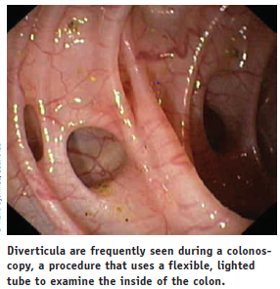

Slide 84
Treatment for Diverticular Disease
Medical treatment for diverticulosis is necessary only if symptoms develop. Because a high-fiber diet may prevent disease progression and the development of intestinal symptoms, patients are advised to increase fiber intake, with an emphasis on insoluble fiber sources.
Fiber should be increased gradually to ensure tolerance. Bulk-forming agents, such as psyllium, can help to increase fiber intake if food sources are insufficient.
Patients with diverticulitis may need antibiotics to treat infections and, possibly, pain-control medications. In mild cases, a clear liquid diet may be advised initially, with progression to solid foods as symptoms resolve. In more severe cases, bowel rest is necessary (oral fluids and food are withheld), and fluids are given intravenously.

Slide 85
Afterward, an oral diet is gradually reintroduced as the condition improves, beginning with clear liquids and progressing to a restricted-fiber diet until inflammation and bleeding subside.
After recovery, a high-fiber diet is recommended to prevent disease progression and symptom recurrence.
Surgical interventions are sometimes necessary to treat complications of diverticulitis and may include removal of the affected portion of the colon.

